Slide 1
Pathway Analysis
What did you get from the high throughput experiment
    You have a list of genes
    Need functional context
    Find out what biological processes are perturbed
    Reduction of data from thousands of genes to a more manageable number of pathways

Slide 2
Numerous tools and software
Mainly three categories
  Overrepresentation Analysis (GO, ORA)
  Functional Class Scoring (GSEA)
  Pathway Topology

Slide 3
Over-representation analysis (ORA)
General theme: statistically computes the fraction of genes in a particular pathway that demonstrate variations in expression
  Algorithms involve hypergeometric tests, chi-square tests, etc.
    Create an input list (some form of significance)
    For each gene set:
      Count the number of input genes
      Count the number of background genes
    Test each pathway for overrepresentation of input genes
  Gene set: GO ontology (GO) term.

Slide 4
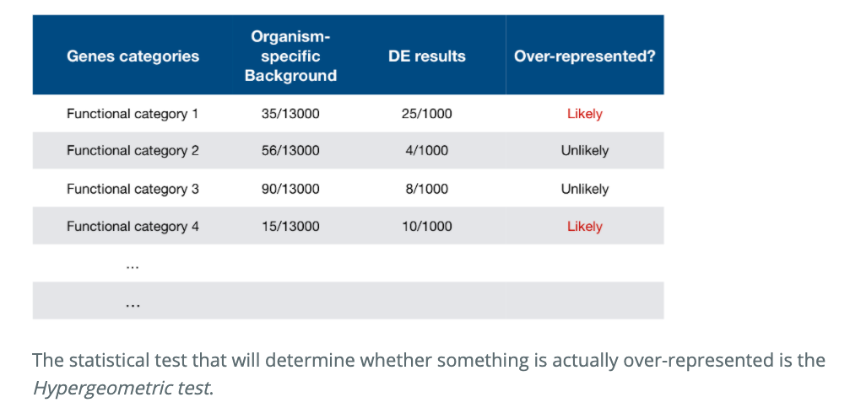
Over-representation analysis (ORA)
https://hbctraining.github.io/DGE_workshop/lessons/09_functional_analysis.html

Slide 5
Examples - ORA
PLoS Comput Biol, 2012

Slide 6
Gene Ontology (GO)
Ontology is the formal representation of a knowledge domain
Gene ontology- pertains to all aspects within the biological domain
    Molecular function – molecular level activities performed by gene products. For example, catalysis, transport
    Cellular component – location relative to cell structures in which a gene product performs a task. For example, mitochondrion, ribosome and other parts of cellular ‘anatomy’
    Biological process – covers larger processes such as DNA repair, signal transduction, a biological process does not have to necessarily equate a pathway.

Slide 7
GO
Genes can be associated with as many GO terms as appropriate
GO is represented by directed acyclic graph where
    Terms are nodes and relationships are edges
    Parent terns are more general than their child term
    Simple tree has only one parent but terms can have multiple parents
Nature reviews, 2008

Slide 8
Functional Class Sorting (FCS)
Theory: While large changes in individual genes can have profound effects on pathways, smaller coordinated changes in sets of functionally related genes can also have significant effects
General algorithm:
  Computes gene-level statistics (fold change, student t-test)
  Aggregate gene level statistics for all genes in pathway into a single pathway-level statistic

Slide 9
Advantages and limitations of FCS
Does not work on an arbitrary threshold (does not discriminate significant and non-significant pools of expressed genes)
FCS uses molecular measurements to detect coordinated changes in gene expression in the same pathway
Limitation- does not analyze interactions between pathways

Slide 10
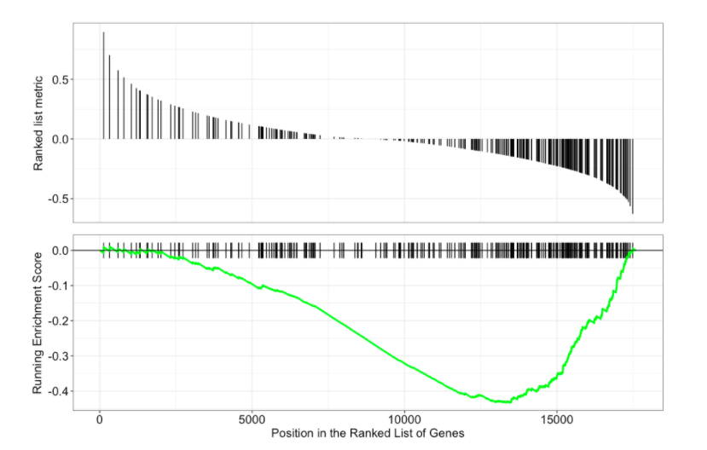
FCS
https://hbctraining.github.io/DGE_workshop/lessons/09_functional_analysis.html

Slide 11
Examples - FCS
PLoS Comput Biol, 2012

Slide 12
Pathway Topology (PT)
Utilizes directionality, function, and topology information.
Information is integrated through a large number of publicly available pathway knowledge base (KEGG, MetaCyc, Reactome, Biocarta, etc)
Provides information on how the genes interact with each other (activation, inhibition) and where they interact (cytoplasm, nucleus)

Slide 13
Approaches and limitations
Varied algorithmic approaches
  Very similar to FCS methods
  Key difference is the use of pathway topology to compute gene-level statistics
Limitations
  Cell-specific gene expression profiles rarely available
  Fragmented knowledge bases
  Inability to model dynamic states of a system
  Weak inter-pathway links to account for interdependencies between pathways

Slide 14
PT examples
PLoS Comput Biol, 2012

Slide 15
Outstanding challenges
Annotation challenges
  Low resolution knowledgebases (alternative splicing, opposing functions, SNPs)
  Incomplete and inaccurate annotations (hypothetical, predicted, pseudogenes, inferred from electronic annotations, lack of thorough curation)
  Missing condition and cell-specific information (all details pertaining experimental curation not available)

Slide 16
Summary
In the last decade, pathway analysis has matured and become the standard for trying to dissect the biology behind high throughput data
Gives you more biological insight than starting with lists of genes
Still an exploratory procedure rather than a pure statistical endpoint

Slide 17
“Best conclusions are made viewing enrichment analysis results through the lens of the investigator’s expert biological knowledge”
–Stephen Turner

