Slide 1
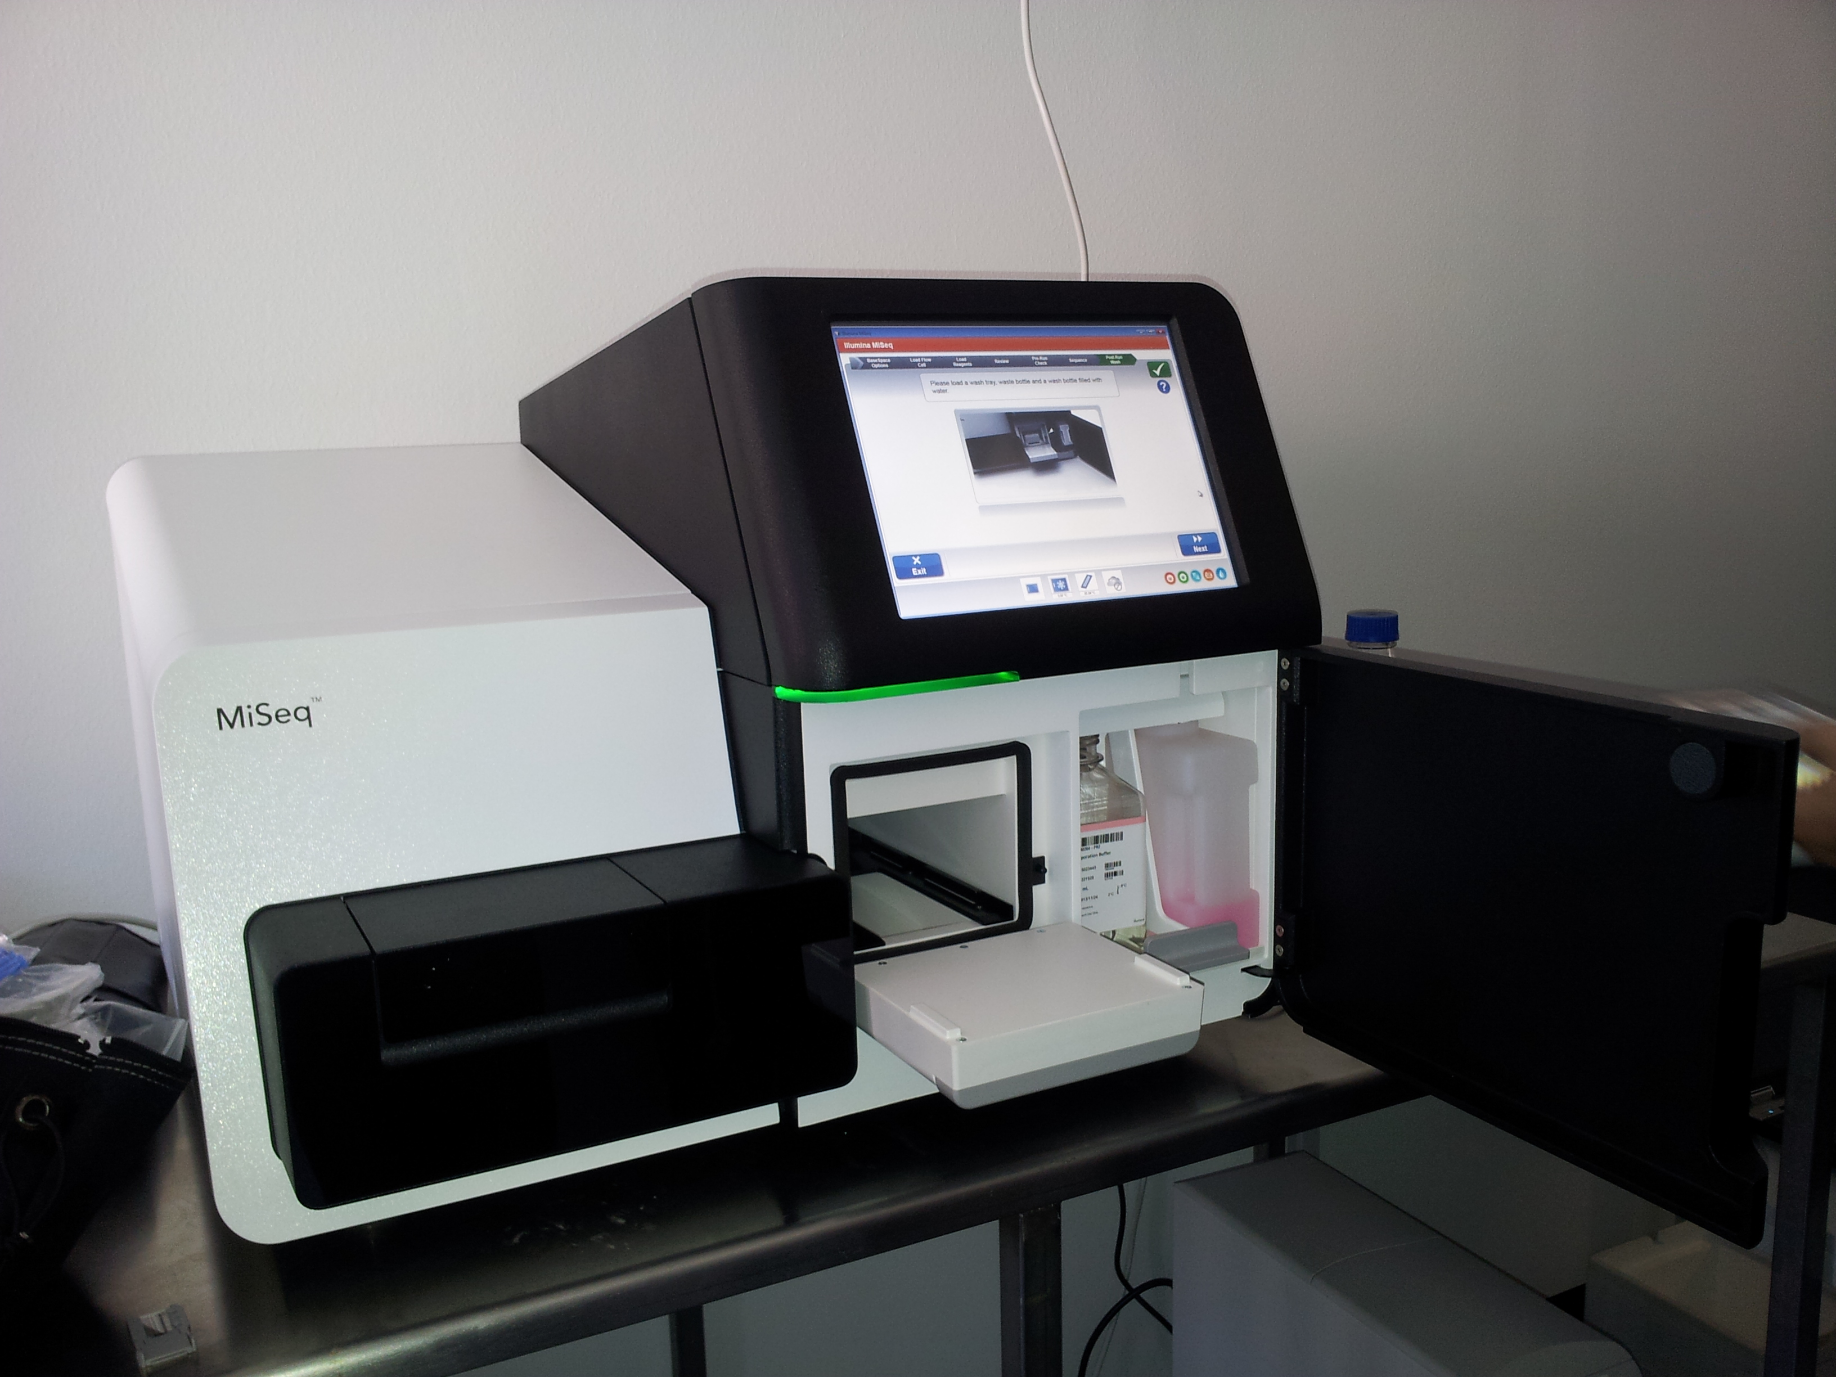
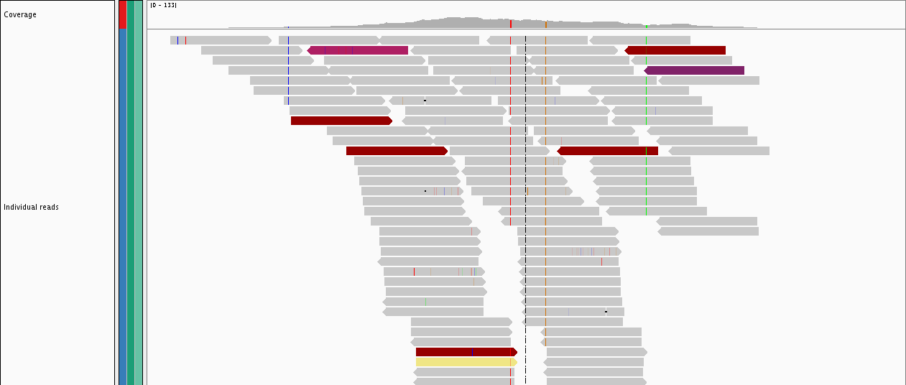
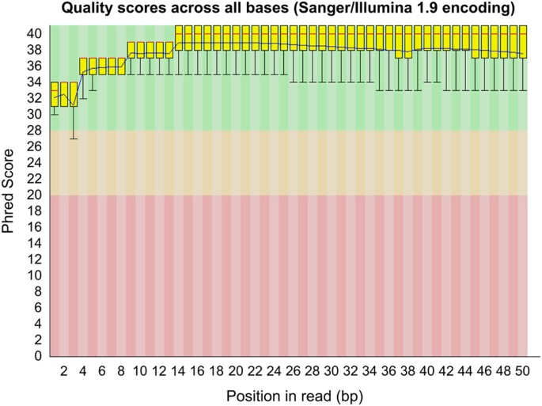
Workflow so far
Gene expression? Exon/allele specific expression? Transcript discovery? Assembly? Small RNAs? Alternative splicing?
Reads
This Photo by Unknown Author is licensed under CC BY-SA
Align to a genome
This Photo by Unknown Author is licensed under CC BY

Slide 2
A transcriptomic approach to elucidate the physiological significance of
human cytochrome P450 2S1 in bronchial epithelial cells

Slide 3
Background
Regulation of CYP2S1 (one of many orphan cytochromes) expression and evaluating impact of these changes on expression using next generation sequencing
Preliminary data suggest cell proliferation impairment and function in metabolism of bioactive lipids

Slide 4
SAMPLE DETAILS
4 bronchial epithelial cell lines with differential CYP2S1 expression.
DNA control, shRNA mediated silencing and exon 3 deletion, overexpression mutant and shRNA control
Sample Id | Mutation
Scram | sh control
Scram | sh control
Scram | sh control
pcDNA | control
pcDNA | control
pcDNA | control
759 | sh silenced
759 | sh silenced
759 | sh silenced
Flag | overexpressed
Flag | overexpressed
Flag | overexpressed

Slide 5
Library Preparation & Sequencing
Illumina HiSeq
12 Libraries
TruSeq mRNA Protocol
1x50 Base pairs Read Length
Single End Sequencing
Bioinformatics:
Alignments
Read counts (to latest human reference)
Differential expression
Pathway (functional annotation) analysis.

Slide 6
WORKFLOW (This will differ based on what your workflow is)
HISAT2
SAM FILES
(Sequence Alignment Mapping)
BAM FILES
(Binary Alignment Mapping)
READ COUNT FILES
(Tab delimited Text Files)
ALIGNMENT
REFERENCE GENOME SEQUENCE FASTA
Important to know the version of software for publication
FASTQ FILES
READ COUNTS
REFERENCE GENOME ANNOTATION GFF3
DIFFERENTIAL GENE EXPRESSION ANALYSIS
FeatureCounts
DESEQ2

Slide 7
Sequence Data

Slide 8
Reference
Homo sapiens(human)
Size: ~3.2 Gb
1-22, X and Y chromosomes,
# genes: ~ 58,000
https://www.gencodegenes.org/human/release_29.html

Slide 9
Sequence Data Alignment Metrics

Slide 10
DIFFERENTIAL GENE EXPRESSION ANALYSIS
Uniquely aligning reads from FeatureCounts (read count generator)
Assigned to only one position in the reference
Increases confidence in expression levels
DESEQ2
R Bioconductor Package
http://bioconductor.org/packages/devel/bioc/vignettes/DESeq2/inst/doc/DESeq2.html

Slide 11
DIFFERENTIAL GENE EXPRESSION ANALYSIS
PCA
Dendrogram
Read
Counts
(Text Files)
DESEQ2
Pairwise
Comparison
Significantly
Expressed
Genes

Slide 12
Results
Fastq files (raw sequence data)
BAM files (alignment files)
Read count text (raw read counts)
Normalized read count text (normalized read counts)
Excel sheet(s) with all expressed genes
Excel sheet(s) with significantly expressed genes (padj ≤0.1)
Excel sheet(s) with significantly expressed genes (positive log2FC)
Excel sheet(s) with significantly expressed genes (negative log2FC)
Pathway analysis files (images, excel sheets)

